Slide 1

LLM Engineering
MASTER AI & LARGE LANGUAGE MODELS

Slide 2

WEEK 2 DAY 3
A classic Gen AI week ahead
What you can already do
Confidently use the OpenAI API including streaming with markdown and JSON generation
Use Frontier APIs
Build UIs for your solutions
By end of today, you'll be able to
Create a Chat UI in Gradio
Provide conversation history in a prompt
Build your first customer support assistant

Slide 3



An AI Assistant is a very common Gen AI use case
LLM based Chatbots are remarkably effective at conversation
On-brand persona
Ability to maintain context between messages
Subject matter expertise to answer questions

Slide 4


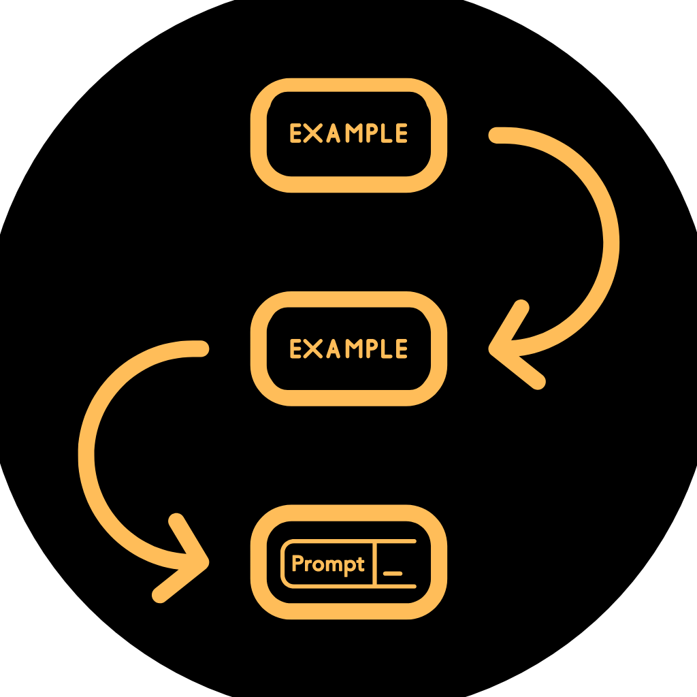
The use of Prompts with our Assistant
The System Prompt
Context
Multi-Shot Prompting
Establish ground-rules, like "If you don't know the answer, just say so"
During the conversation, insert context to give more relevant background information pertaining to the topic
Provide example conversations to to prime for specific scenarios, train on conversational style and demonstrate complex interactions
Provide critical background context

Slide 5
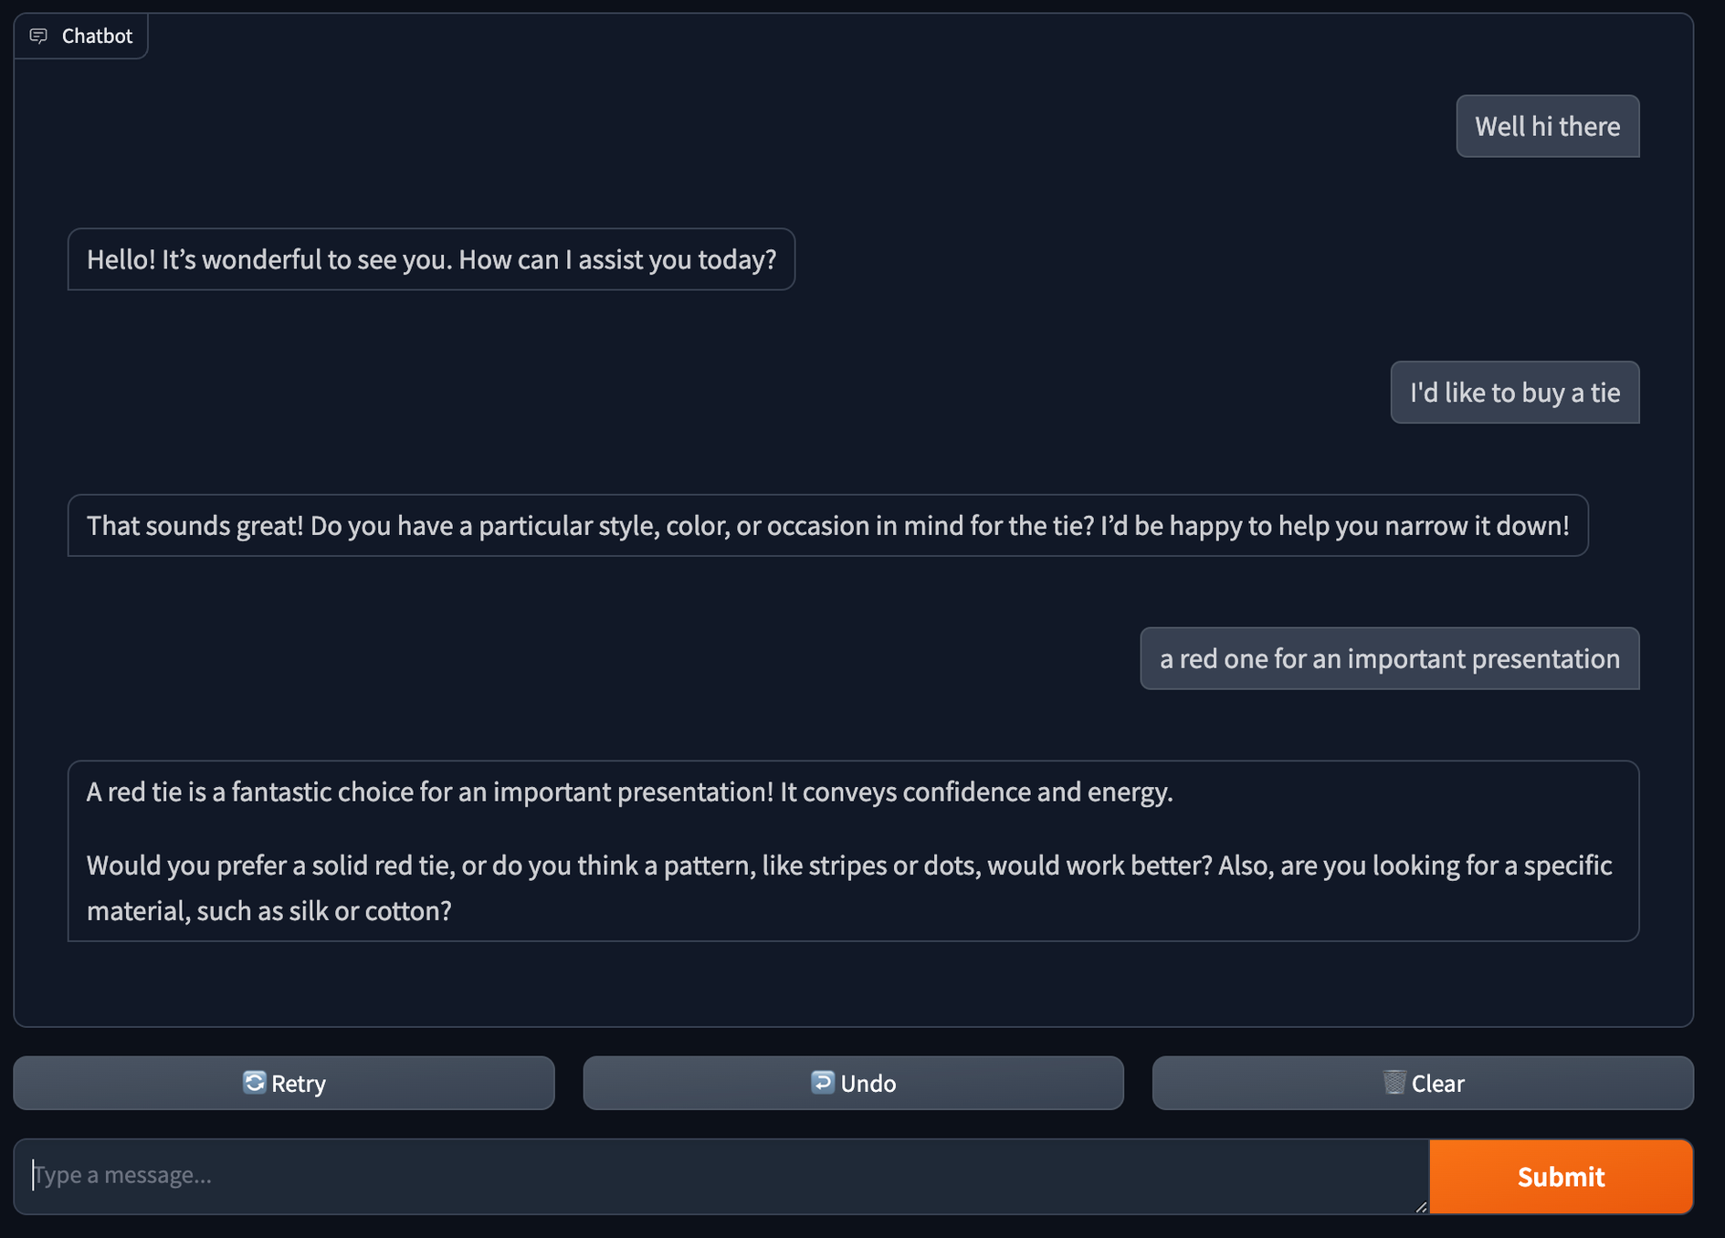
Your first chatbot

Slide 6

PROGRESS
Congratulations - 20% milestone
What you can now do
Overview of transformers and explain key terminology
Confidently code with the Chat Completions API
Build an AI Chatbot Assistant including an interactive UI
After the next session you'll be able to
Explain the use of Tools
Create a Function-calling Tool
Code an AI Assistant that incorporates Tools

